Slide 1
IBM HR Analytics: Employee Attrition & Performance
Presented by: Ashok Nagar
Tools: Python, Pandas, Seaborn, Matplotlib

Slide 2
Problem Description
- Objective:
To understand the factors influencing employee attrition and performance at IBM.
- Why Important?
Employee attrition impacts productivity, company culture, and cost.
- Dataset Source:
IBM HR Analytics Employee Attrition & Performance dataset.

Slide 3
Insight 1 – Attrition Distribution
- Majority of employees stayed.
- Around 16% showed attrition.
Insight 2 – Age vs Attrition
- Higher attrition among employees aged between 25–35 years.
- Indicates younger workforce is more likely to leave.

Slide 4
Insight 3 – Monthly Income vs Attrition
- Employees with lower income show higher attrition.
- Salary is a significant factor for retention.
Insight 4 – Department-wise Attrition
- Sales and HR departments see higher attrition.
- R&D shows better retention.

Slide 5
Insight 5 – Job Satisfaction
- Employees with low job satisfaction have higher attrition.
- Job satisfaction correlates with employee retention.
Insight 6 – Work-Life Balance
- Poor work-life balance leads to higher attrition.
- Companies should address work pressure and flexibility.
Insight 7 – Performance Rating
- No clear direct correlation observed.
- Even high performers may leave, possibly due to lack of recognition or growth.

Slide 6
Conclusion
- Key Factors Driving Attrition:
- Age (young professionals)
- Low income
- Job dissatisfaction
- Work-life imbalance
- Recommendations:
- Salary restructuring for lower-income employees
- Improve job satisfaction and work culture
- Retention programs focused on young and high-potential employees.

Slide 7
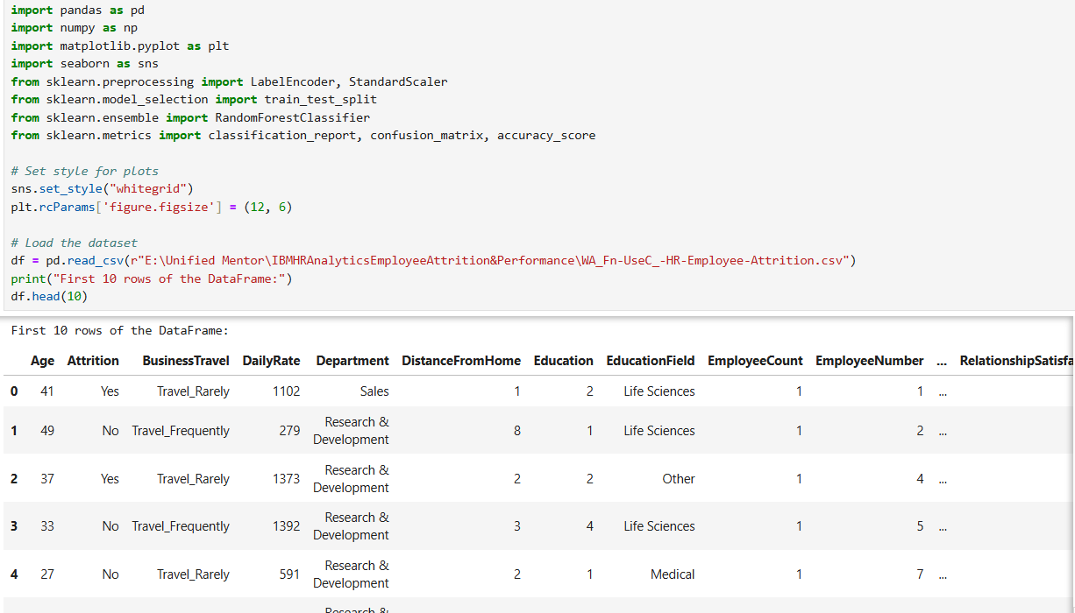
Python Code
Step 1: Data Collection - Load and inspect the dataset

Slide 8
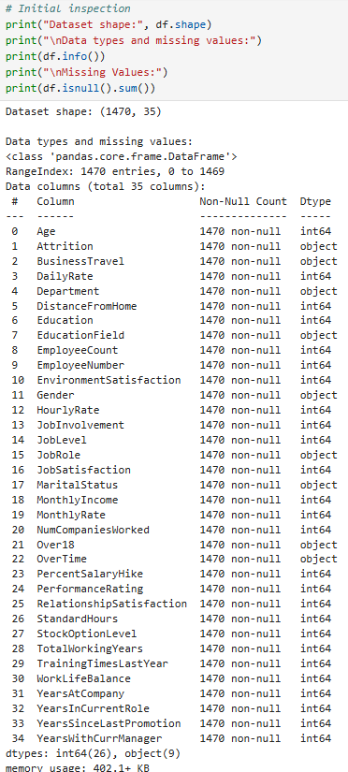
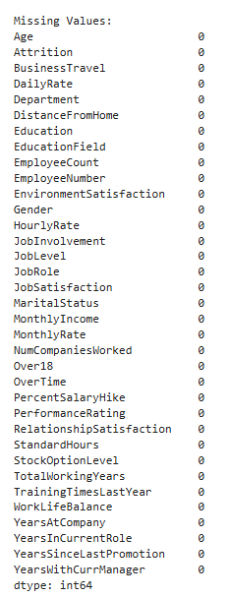

Slide 9
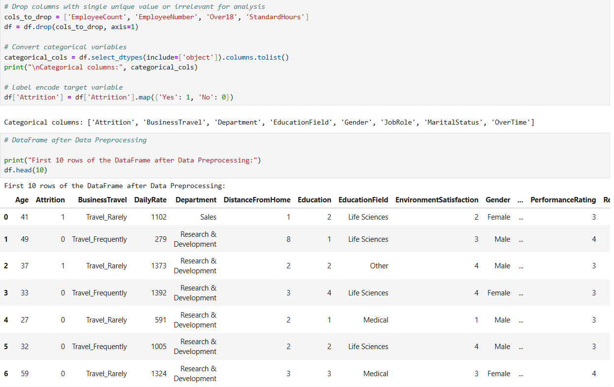
2. Data Preprocessing

Slide 10
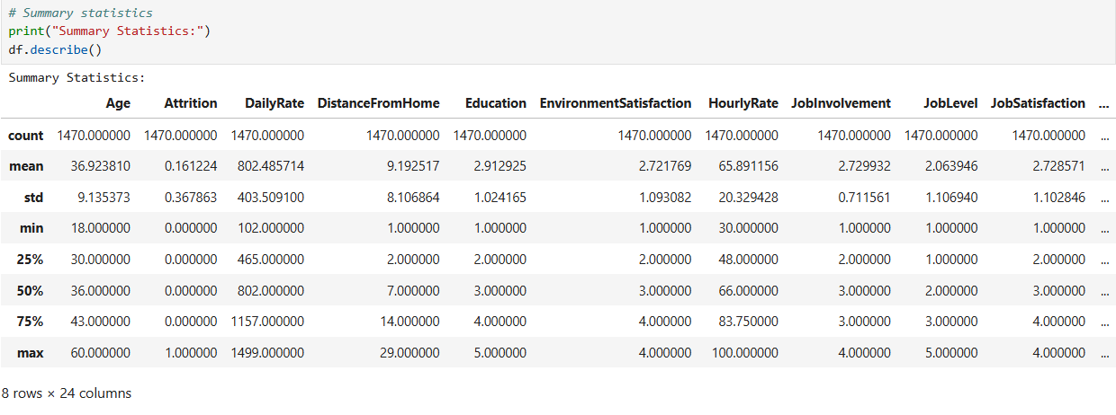
3. Exploratory Data Analysis (EDA)

Slide 11
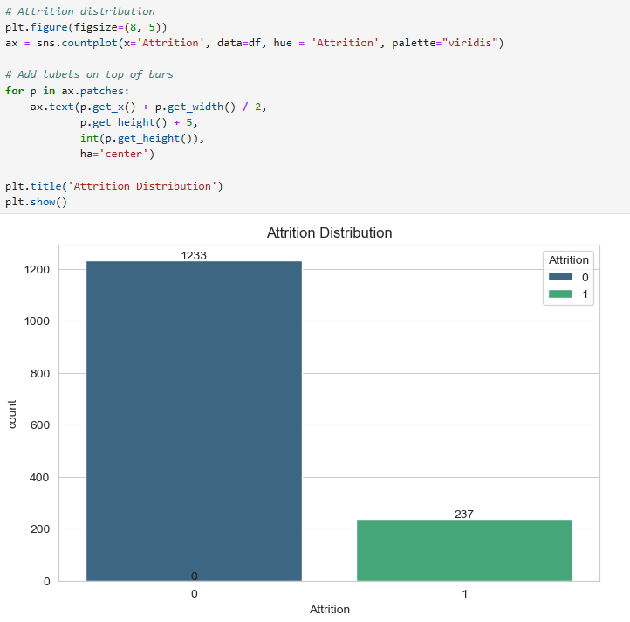

Slide 12
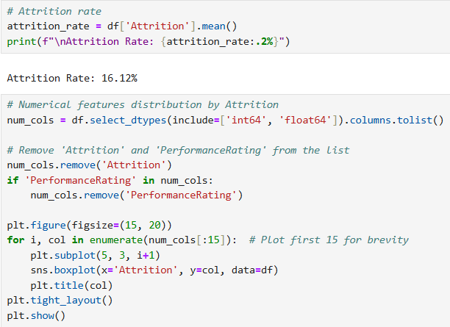

Slide 13
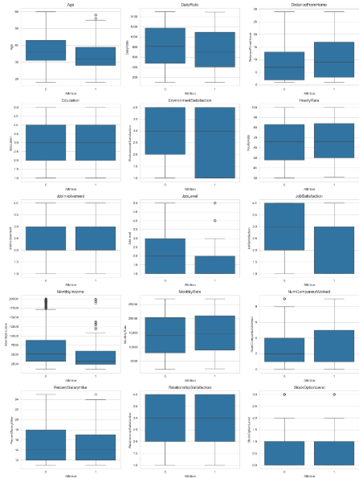

Slide 14
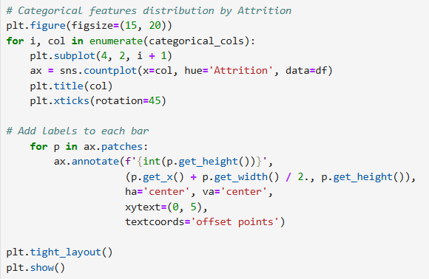

Slide 15
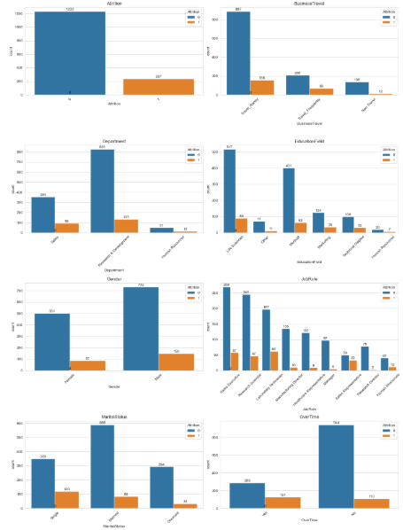

Slide 16
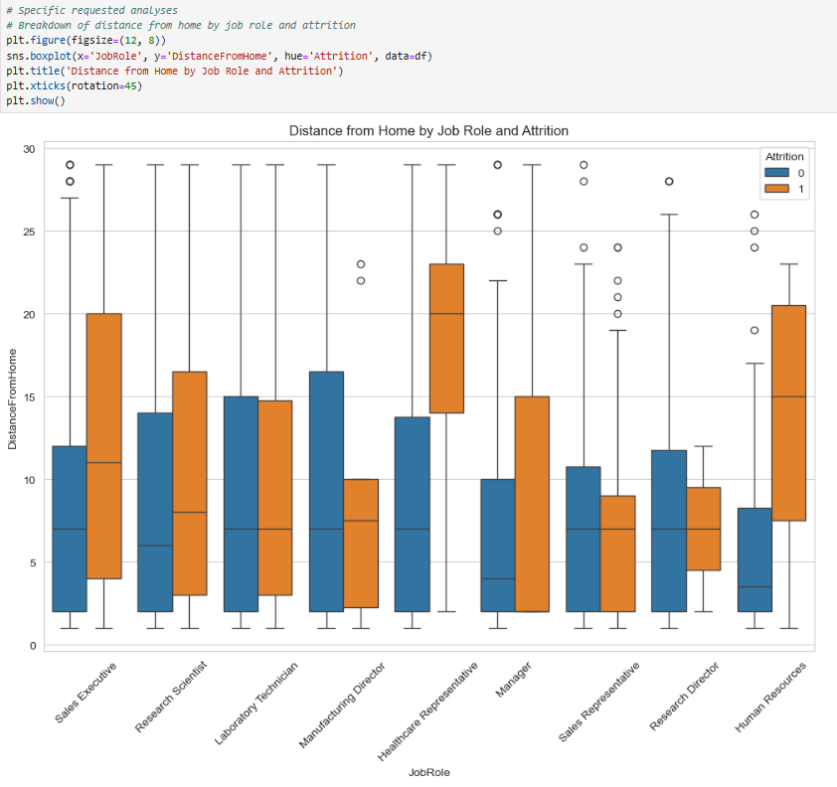

Slide 17
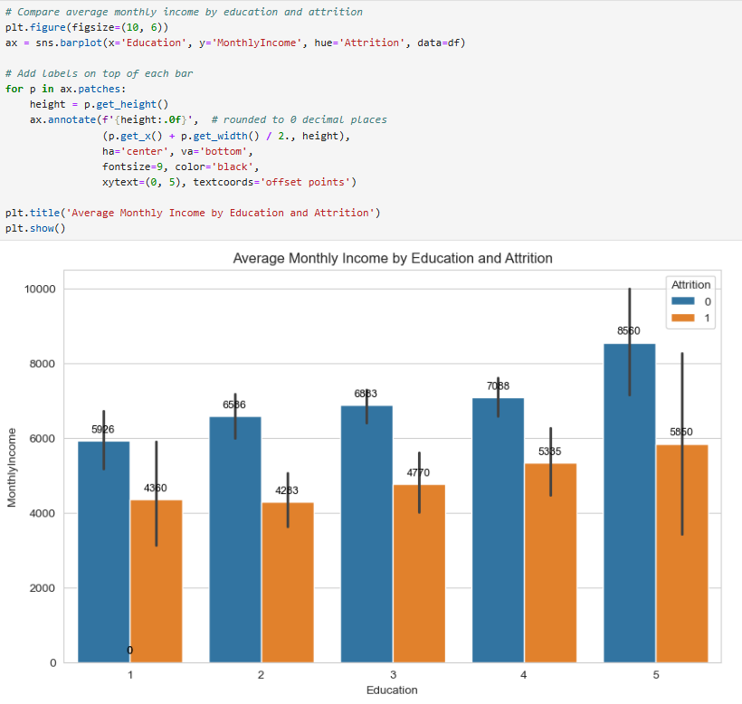

Slide 18
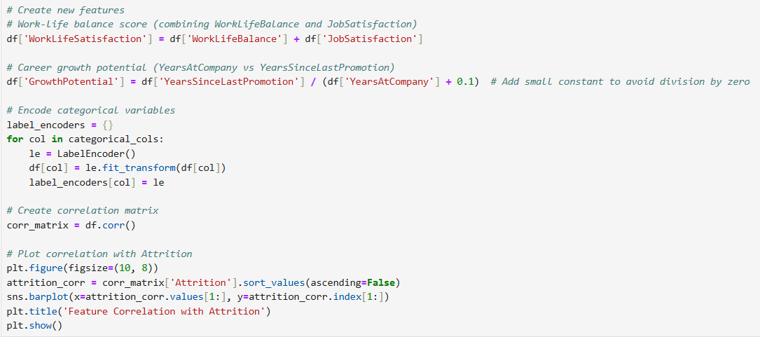
4. Feature Engineering

Slide 19
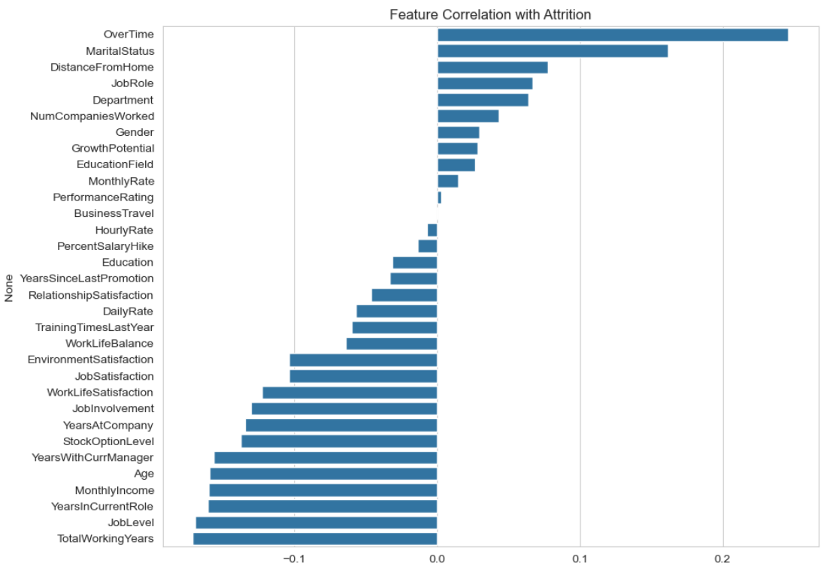

Slide 20
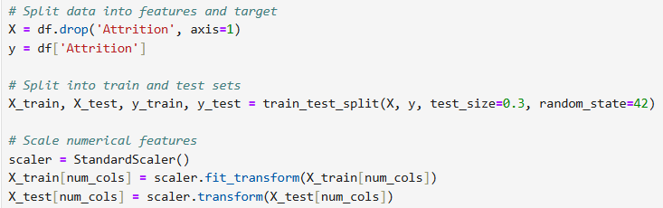
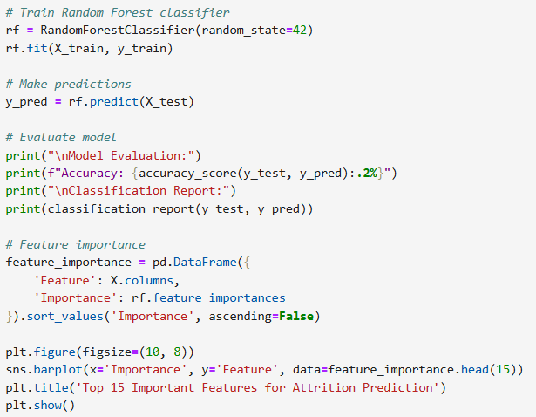
5. Modeling Preparation
6. Model Building

Slide 21
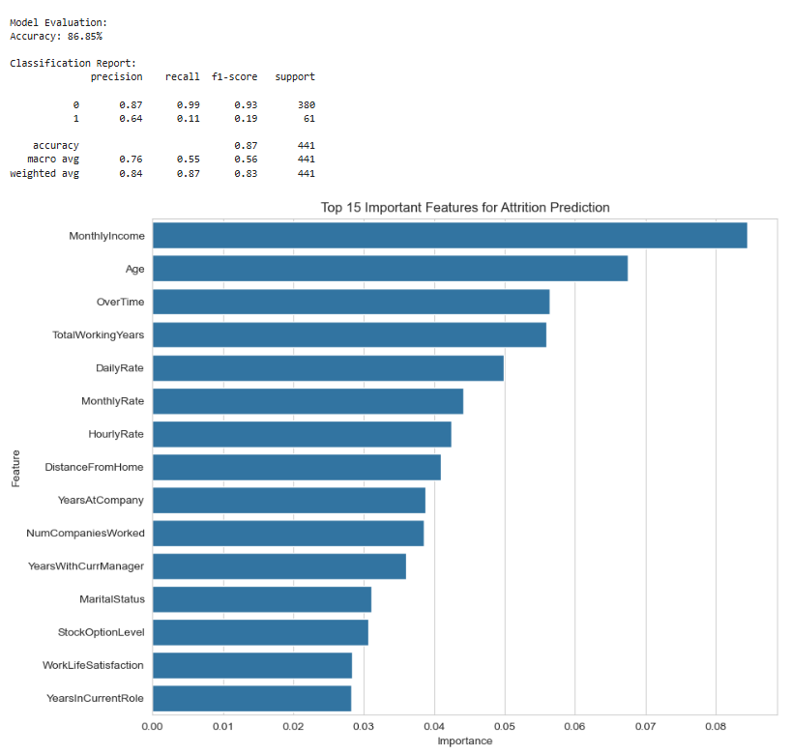

Slide 22
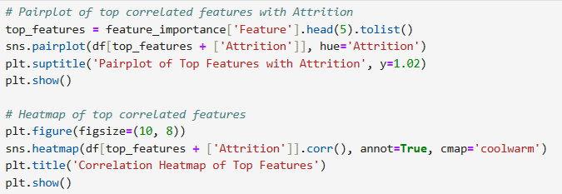

Slide 23
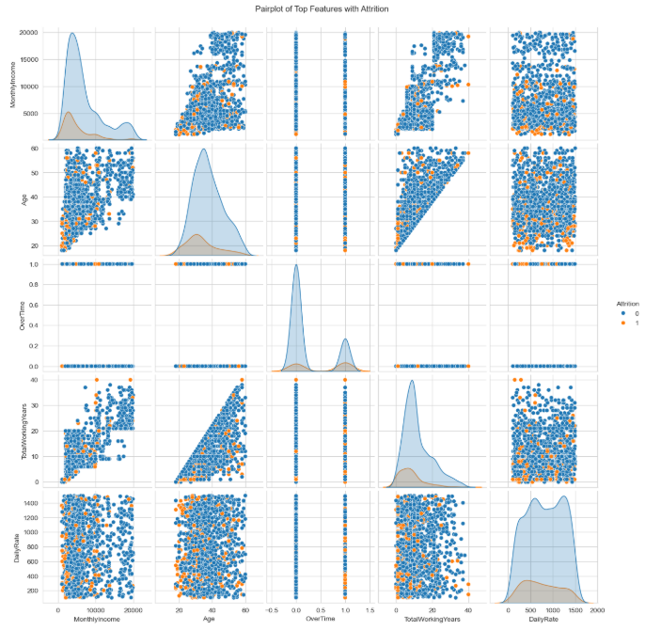

Slide 24
